Slide 1
DevOps
QACDEVPUP

Slide 2
Introduction
This course aim is to provide;
An overview of the main tools and components involved in DevOps and CI
The ability to support software development and deployment.
The course begins with looking at an overview of;
Continuous Integration and Continuous Deployment
The Linux Operating System
Automating key parts of a CI Pipeline

Slide 3
Continuous Integration and Continuous Deployment
Module one

Slide 4
Continuous Integration (CI)
What is CI?
It is a software development practice, which states members of a team will integrate their work frequently.
What do we mean by ‘integrate’?
When a team integrate their work, they are joining individual members code base into one centrally located repository.

Slide 5
Continuous Integration (CI)
When should we integrate?
We can schedule integrations for specific times in a working day or whenever a SCM repository is updated.
We can build, test and deploy our integrations, using a variety of tools.
This processes has teams integrating their work much more frequently.
It exposes integration issues and conflicts much quicker, reducing time and money spent on fixing thiese problems.

Slide 6
Continuous Integration (CI) Principles
We should maintain a single source code repository for our entire project.
This ensures teams are completely aware of what is happening on a project. It also ensures all our code can be polled by the integration tool.
Utilise Artifact repository tools to deploy our produced artifacts, to a variety of environments.
These will be covered in more depth in a later module.
Automate whenever possible
The key to DevOps is automation - we should be reducing the workload on tasks that can be automated to free up the developer or DevOps engineer to work on other tasks.

Slide 7
Continuous Delivery (CD)
What is CD?
Continuous Delivery is all about teams continuously delivering new versions of a product to the customer by reducing cycle time between an idea and a usable piece of software.
We accomplish through the use of automation from build, deployment, testing, and release.
Designed to be repeatable and reliable
One we have completed a delivery, the release process is likely to be the same.
Customers can enjoy new or enhanced features at a much quicker pace.

Slide 8
Continuous Delivery (CD) - Examples
The following are some examples of CD in action;
Facebook
Twitter
Windows
Can you think of any examples of when CD is not followed?
Notes:
Trainer discusses how each bullet point follows best CD practice.

Slide 9
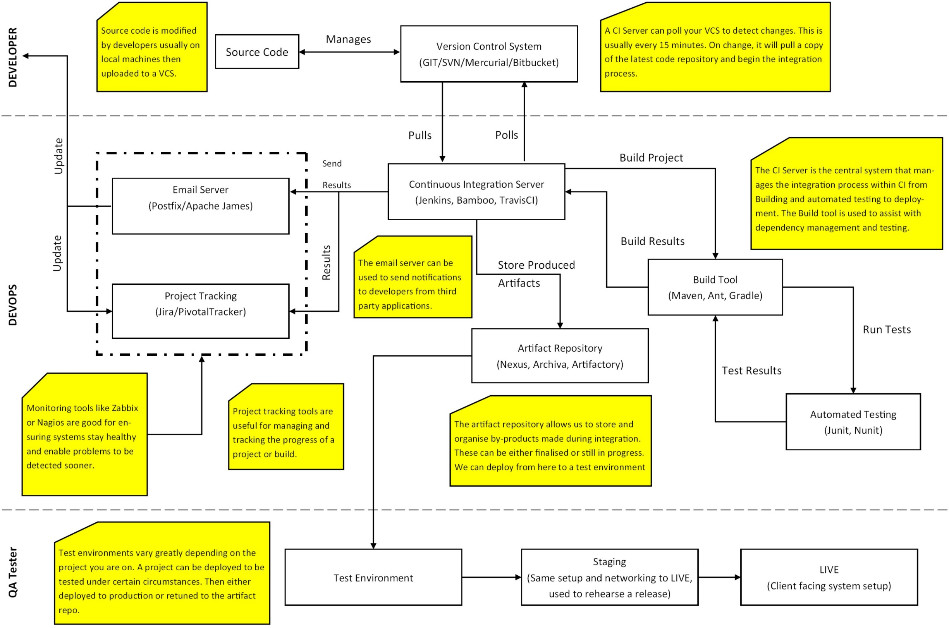
CI pipeline
Notes:
Take the consultants through each section, pointing out each section and have an open discussion with the room about it.

Slide 10
TASK: Creating Example Systems

Slide 11
Linux System Administration Part 1
Module Two

Slide 12
Linux OS
What is Linux?
Linux is an open source operating system, which has been developed collaboratively. There is not a single person responsible for the development of the systems or the ongoing support.
Linux differs from Windows and Mac as it allows much greater flexibility and control over specific tasks.
Linux initially begin as a server-based OS but has since become a widely used desktop OS and is built into a number of devices.
Sat Navs
TVs
Laptops / Desktops / Mobile Devices

Slide 13
Linux OS - Distributions
Linux has a number of distributions that offer different functionality when using the OS.
Each distribution manages software (or packages) through the use of a Package manager. These differ depending on the distribution being utilised.
There a many types of distribution in the world, however the following four are more used than most;
Ubuntu
CentOS
Fedora
Mint

Slide 14
Distributions - Ubuntu
Ubuntu is arguably one of the most popular Linux distributions available with its biggest USP being the ease of use the system has.
You can easily install and customise this OS to your own needs. The tool was designed to be simplistic enough for beginners, but not limit the potential for a more advanced user.
Ubuntu updates every six months with new features and improvements to make the continued experience to be positive.
Ubuntu is primarily targeted at; home users, developers and businesses.
Ubuntu utilises APT as it’s package manager.

Slide 15
Distributions - CentOS
CentOS is a stable distribution of Linux which was initially apart of Red Hat Enterprise Linux (RHEL).
CentOS is a community supported distribution, supported by a number of people in the development community.
The OS aims to be functionally compatible with RHEL, and was designed for cloud or served-based operation and development.
CentOS is one of the most popular versions of Linux Enterprise.
CentOS utilises YUM as a package manager.

Slide 16
Distributions - Fedora
Fedora used to be apart of the RHEL distribution. It opted to become its own distribution after RHEL moved to a subscription-based enterprise system.
This OS updates every six months and is usually at the forefront of technology upgrades, driver and software updates. It is a fast and stable release.
Targeted users include; Home, Development, Cloud and Server
Fedora utilises YUM as a package manager.

Slide 17
Distributions - Mint
Linux Mint was designed to be a modern and elegant operating system which is both powerful and easy to use.
Arguably one of the most popular desktop Linux distributions, and ranked 3rd most widely used home operating system just behind Windows and Mac OS.
Mint is a free, open-source, out-of-the-box operating system.
Mint utilises APT as it’s package manager.

Slide 18
SSH - Secure Shell
Once we’ve set up our system it’s time to simulate a real-world working environment.
We use a tool called puTTY to Secure SHell (SSH) into the virtual machine from your windows training machine. There are many other tools out there, but for this course we will be using this one.
One some setups of Linux you may need to run the following command to ensure you are able to SSH successfully.
sudo apt-get install –y openssh-server openssh-client
This should display a few bits of information and either download and install both or it will tell you it is already installed on your system.

Slide 19
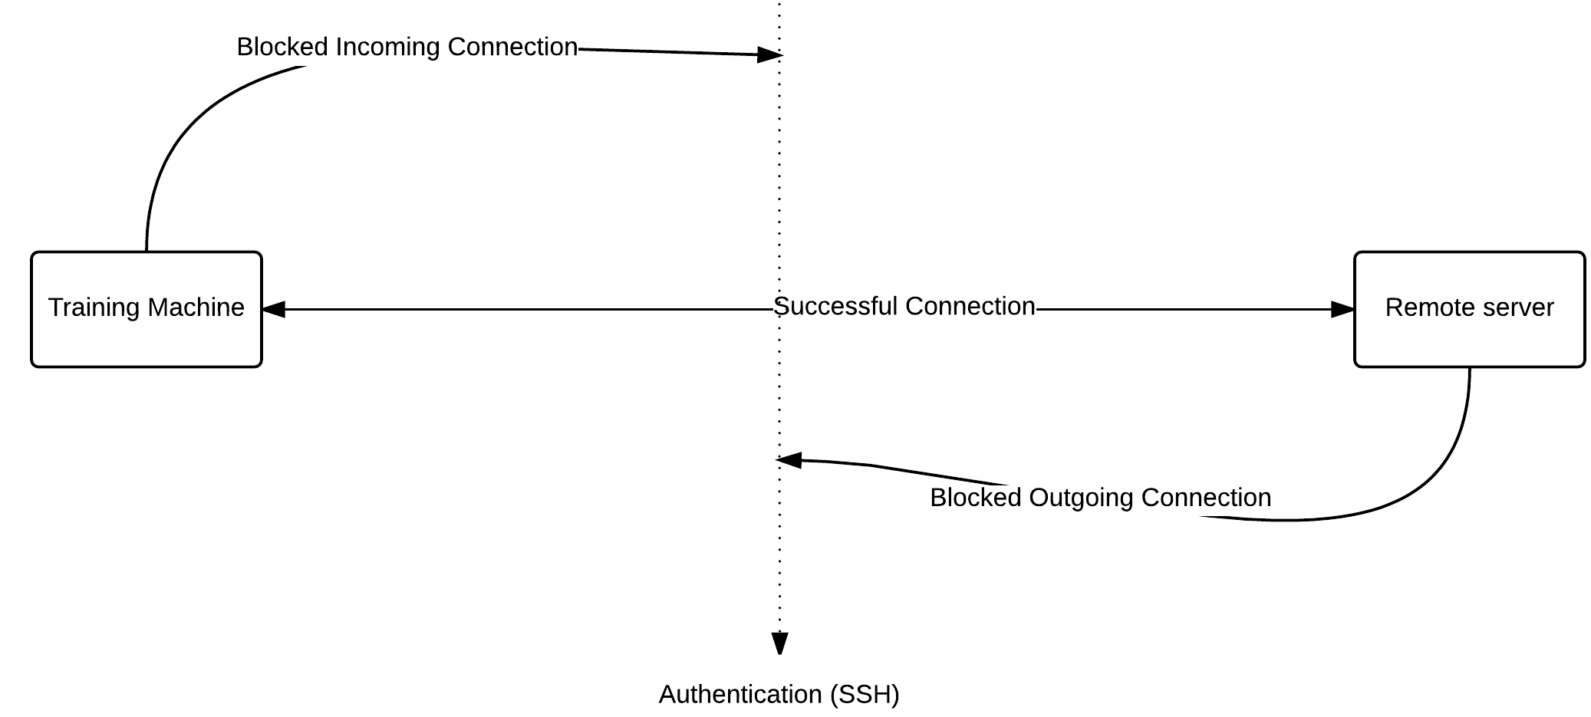
SSH - Secure Shell

Slide 20
SSH - Secure Shell
You can find putty in the LocalInstall C Drive folder. Take a copy of this and place it on your desktop.
When you open the application enter your Linux-box username along with the IP address in the following format:
USERNAME@COMPUTERIP
Ensure the port is set to 22 and that you’re connecting with SSH from the radio buttons.
When you press connect, it should ask you to save the Fingerprint, press yes and enter your password to login to the VM terminal.
If this does not work – check your firewall is disabled, and you’ve installed the SSH services.

Slide 21
Linux Virtual Machine
When launching virtual machines there are a number of different ways and we will cover all of them during this course.
Using an ISO file with Virtual Box
Using a provisioning tool
We will be giving the first one a go now. To do this you will need the following;
Oracle VM Virtual Box
Linux Ubuntu ISO file
Your files can be found in C:/LocalInstall

Slide 22
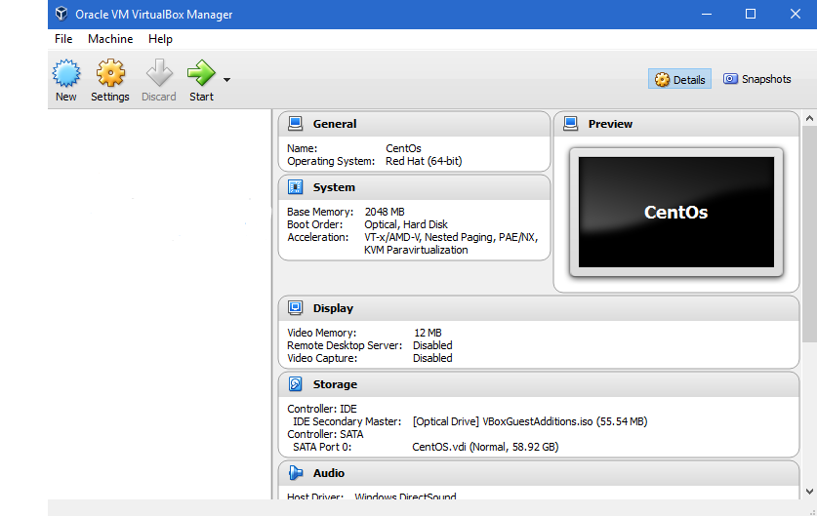
Linux Virtual Machine

Slide 23
TASK: Your first Virtual Machine

Slide 24
TASK: Terminal Exploration

Slide 25
Linux System Administration Part 2
Module four

Slide 26
The Terminal
The terminal is an important aspect of Linux for any development work, as you will be constantly switching directories, copying files and installing packages as well as creating, executing and deploying automated scripts.
There are two initial commands you should be aware of, as you are likely to use them a lot more than the rest.
sudo
apt-get / yum

Slide 27
The Terminal - Commands
There are a number of commands that will be used whenever you’re conducting some sort of administrative task on Linux.
Knowing these commands and understanding the differences is quite key.
What commands should you use regularly?
What types of commands do you know?
What types of command should you avoid?
http://beginlinux.com/twitter/1094-the-beginners-guide-to-the-ubuntu-terminal
https://help.ubuntu.com/community/UsingTheTerminal
Notes:
This is a good place to have an open discussion about a variety of different commands.
Tar / Man / ssh / rm -rf / cd / mkdir / touch.
As the group for their experiences.

Slide 28
Bash Scripting
#!/usr/bin/env bash
#echo the hello world phrase
echo “Hello World”
Most scripts come in .sh format which is a Bourne Shell Script file. Most various of UNIX-like operating systems can recognise and understand this file type.
It’s important to note that these files, have no set language, the contents is interpreted by the shell, unless you specify a particular interpreter on the first line.
There are different ways of declaring your bash file but using the top line as shown, is universal across all distributions of Linux.

Slide 29
Bash Scripting
#!/usr/bin/env bash
#update the package manager sources
sudo apt-get update
#display network information of system
ifconfig
#Install Java
sudo apt-get install -y openjdk-7-jdk
sudo apt-get install -y openjdk-7-jre
echo "Java Installed"
The example on the right shows a .sh file with a specified interpreter using BASH (Bourne Again Shell) and is currently detailing a hello world script.
You can see that the ‘Hashtag’ (#) symbolises a comment within the script file.
Other commands are being executed as normal in the file, however bare in mind these will run in an order starting from the top of the file.
The following link shows more examples;
http://tldp.org/HOWTO/Bash-Prog-Intro-HOWTO.html

Slide 30
Task: Creating a Script file

